Slide 1
Team Cinco
Amber Moran - Andrew Haug - Mark Rudolph -Sam Guzman - Sam Lin

Slide 2

Motivation
Hired by a consulting firm we are asked to examine the return on investment for vacation rentals in 5 major cities.

Slide 3
Summary
What are the costs associated with each city?
Median house price per city?
Bedrooms per house?
Count of listings (Competition) in each city?
What are the benefits associated with short term rentals in each city?
Median rental price per night?
Count of nights rented per year (Occupancy rate)?
Return on investment? ROI per house by bedroom count?
Comparing our costs to our benefits which city offers the greatest return on investment?

Slide 4





Investment Cities
Austin
Boston
Chicago
San Diego
Seattle

Slide 5



Data Collection
Sources needed:
Home Market Values
Realtor.com
Vacation Rental Values
Inside Airbnb

Slide 6
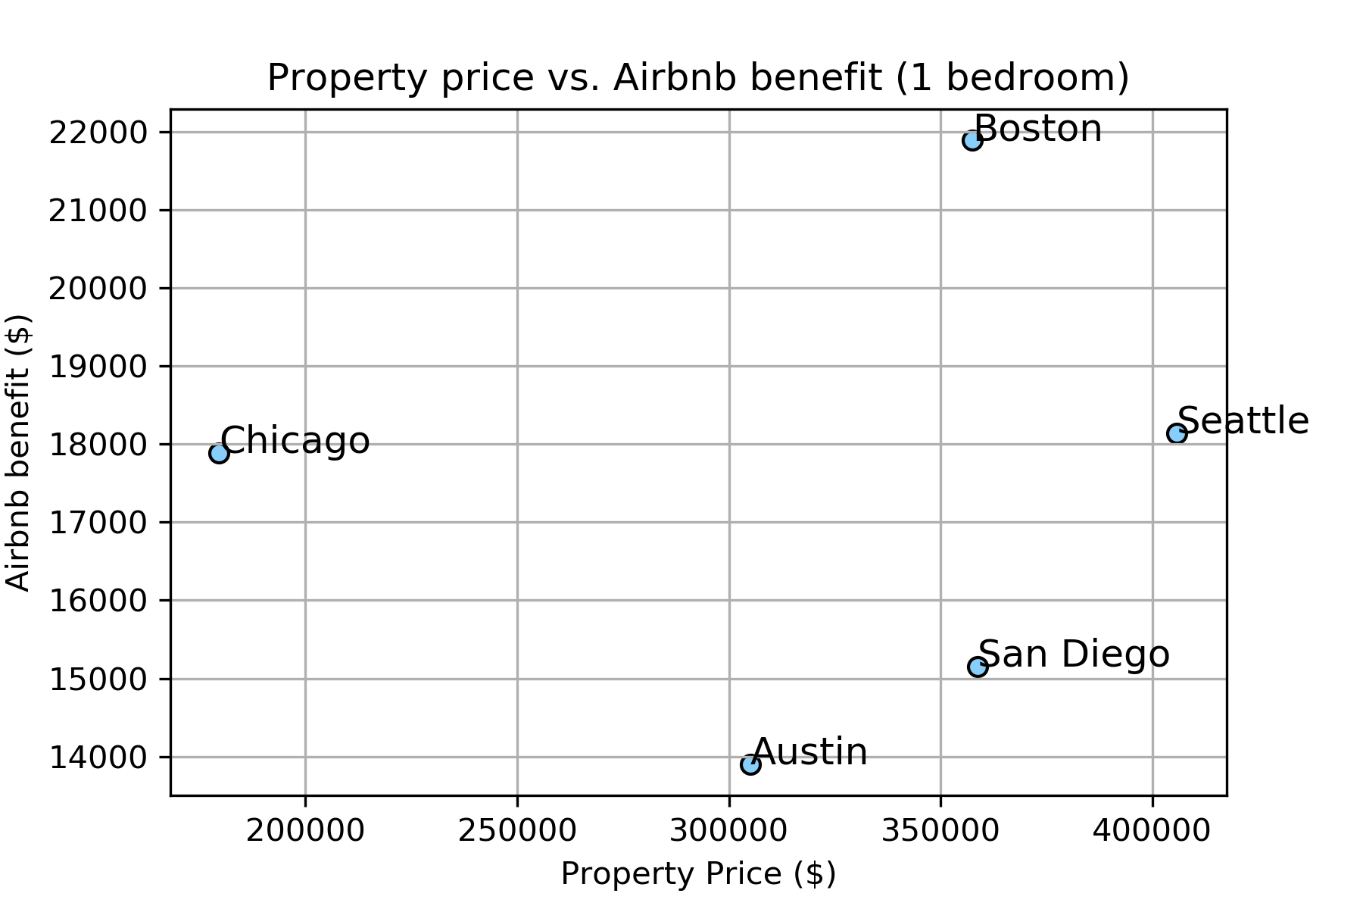
Scatter 1 Bedroom

Slide 7
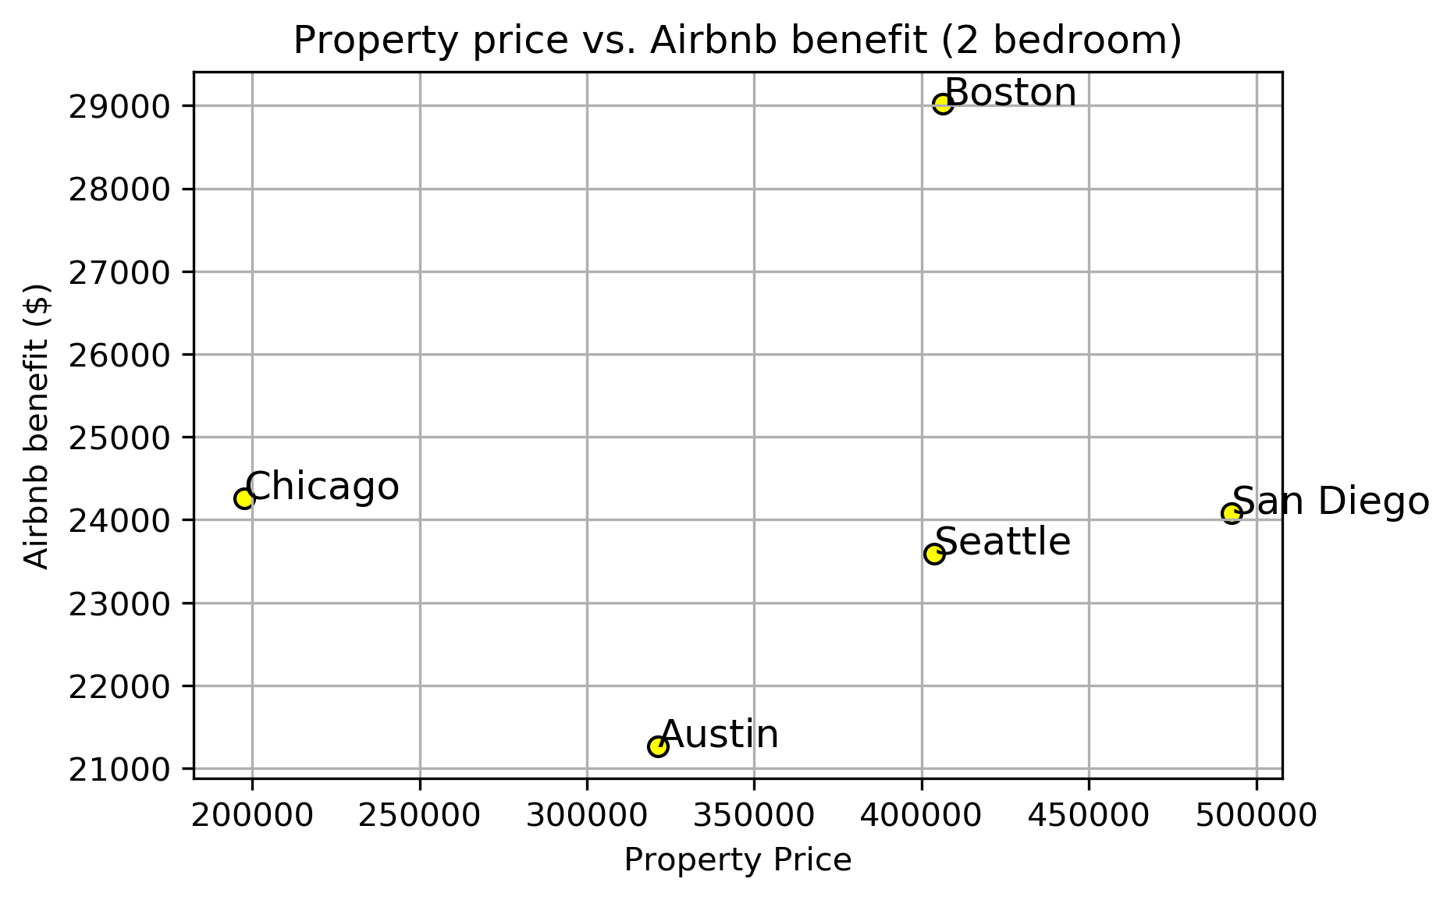
Scatter 2 Bedroom

Slide 8
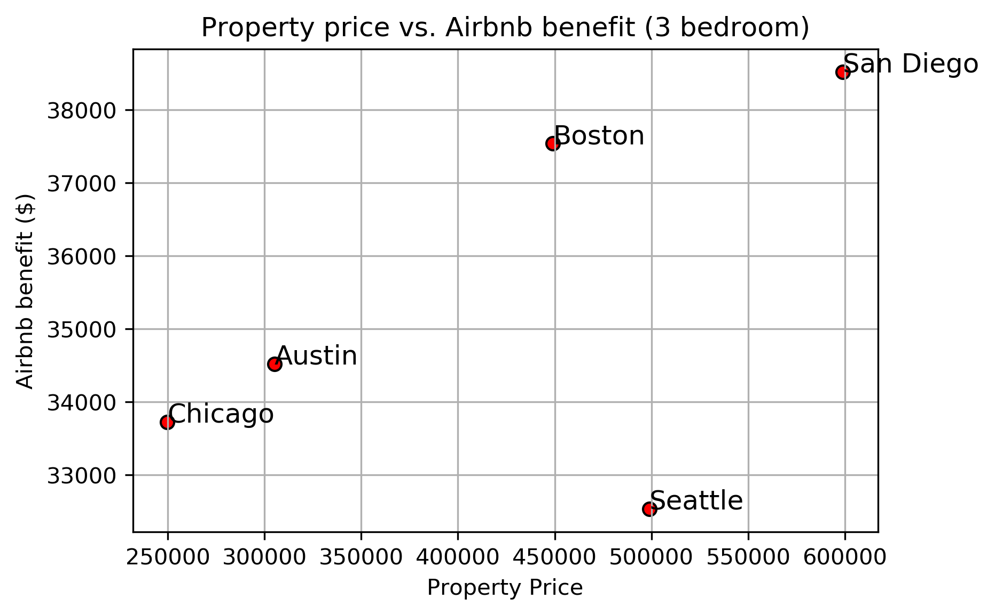
Scatter 3 Bedroom

Slide 9
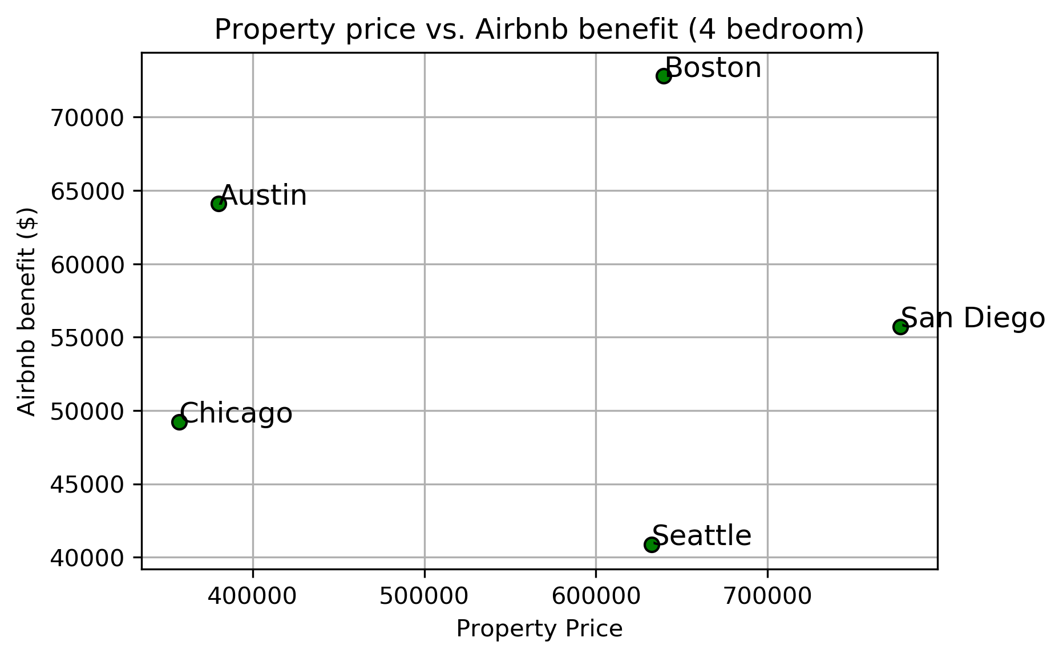
Scatter 4 Bedroom

Slide 10
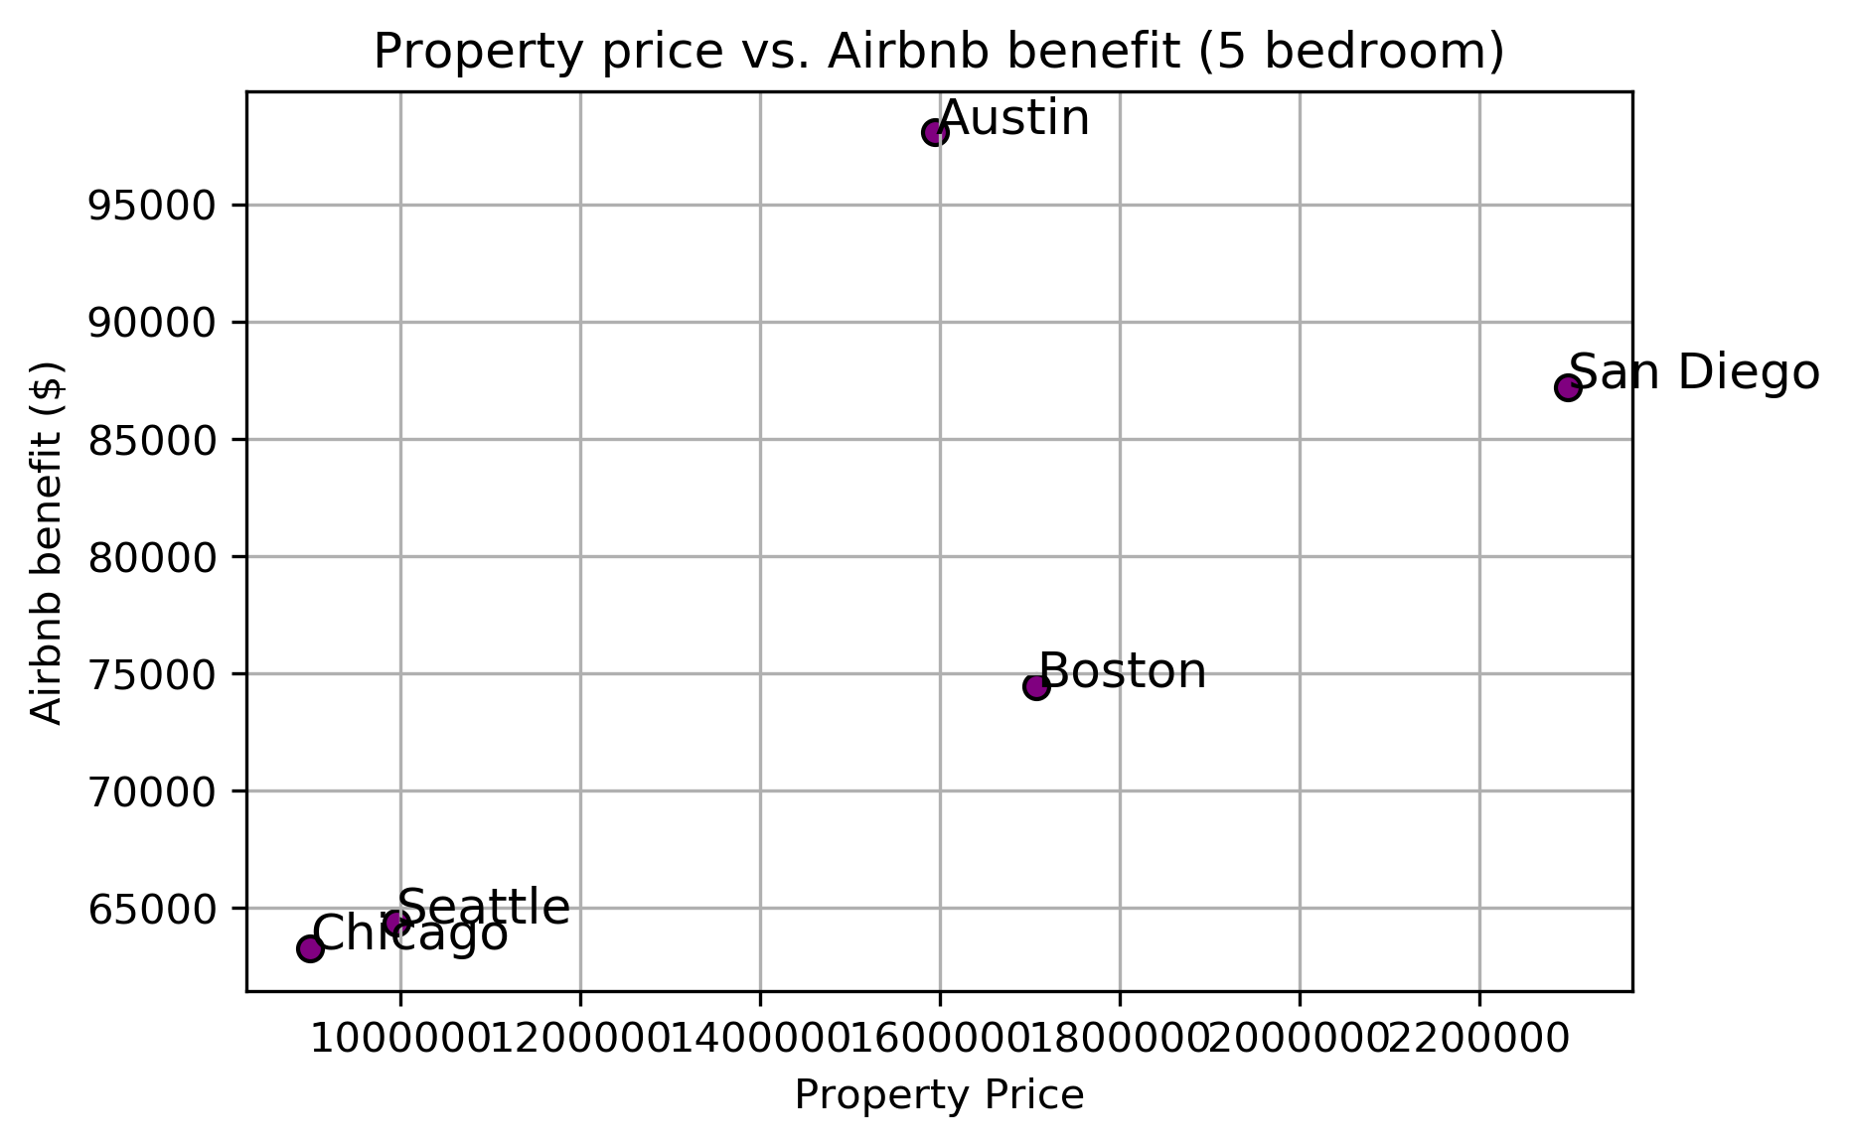
Scatter 5 Bedroom

Slide 11
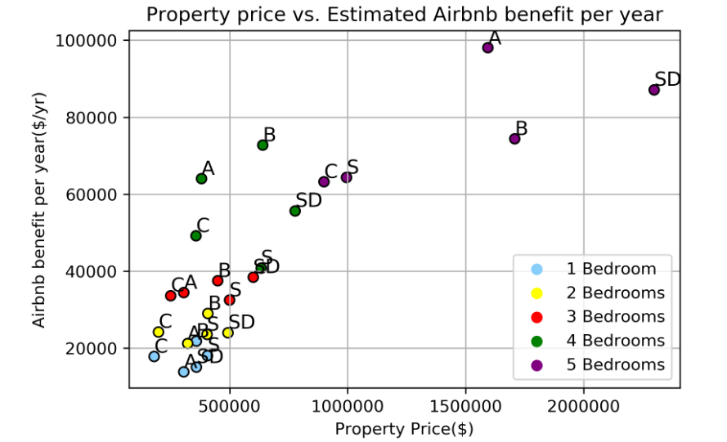
Total Scatterplot

Slide 12
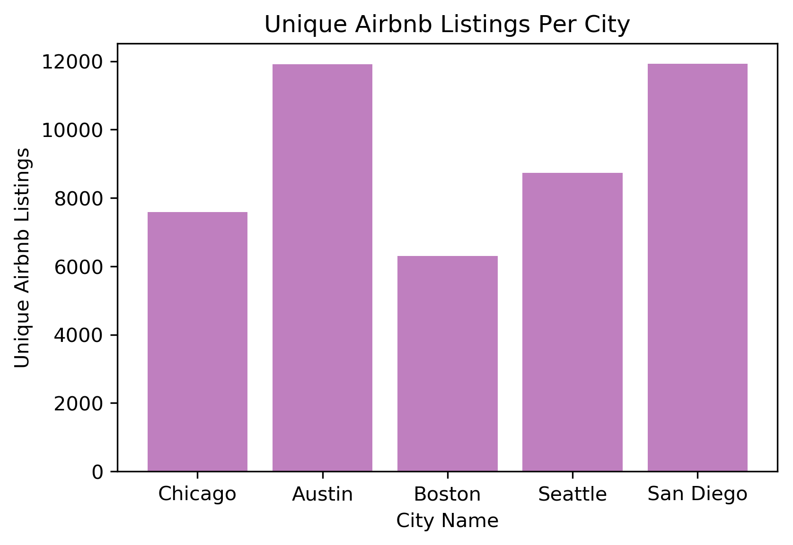
Airbnb listings per city

Slide 13
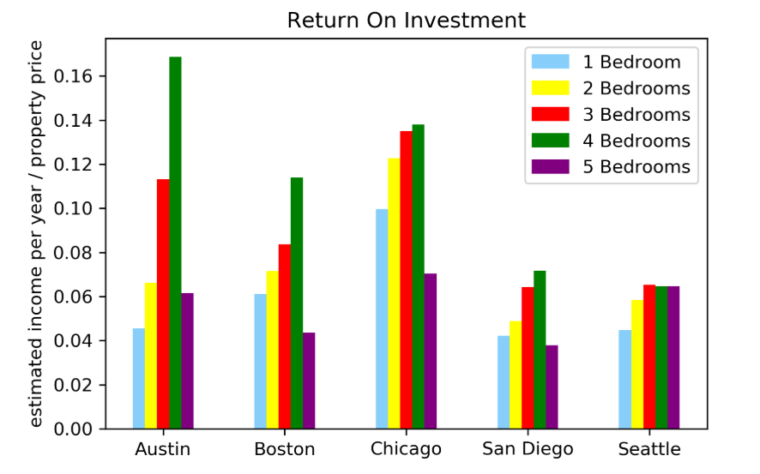
Return on Investment

Slide 14

Conclusions
Based on overall return on investment
Chicago – 0.11%
Austin – 0.09%
Boston – 0.07%
Seattle – 0.05%
San Diego – 0.05%

Slide 15
Conclusions/Observations
Chicago provides the greatest return on investment when looking at all bedroom types
The 3 and 4 Bedroom homes gain our strongest recommendations
The best individual return on investment is Austin’s 4 Bedrooms homes (0.17%). The worst investment is San Diego’s 5 Bedroom homes (0.04%)
For 4 out of the 5 cities the 4 Bedroom home provided the highest return on investment
As the count of bedrooms increases, the data points become less clustered.
Austin (11919) and San Diego (11922) had the most unique listings and were only separated by 3 total listings!

Slide 16
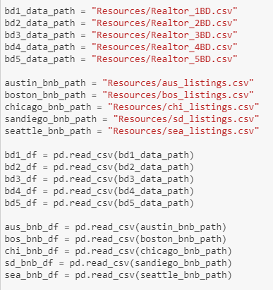
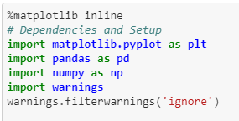
Coding Skills
Imported csv files
Panda for data frames
Matplotlib for graphs

Slide 17
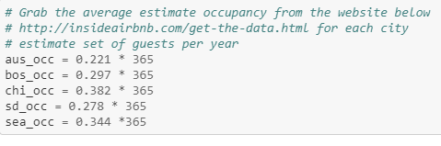
Data Obstacles
Our original data collection did not include occupancy rates on the csv files.
We found the statistics for occupancy rate in each city on the front end of Inside Airbnb’s website
Using that data we were able to create a new column and merge it into our data frame before we plotted our graphs

Slide 18
Post Mortem
What would we research next or in more detail if we had more time?
Examine more cities using existing code
Breakdown zip codes in each city
Create a Geo-map based on longitude and latitude
Use new data source for long term rental markets return on investment
Use Realtor.com csv to analyze exit strategy or ability to sell quickly and at what value

Slide 19

Questions & Answers

Slide 20
Resources
Airbnb - http://insideairbnb.com/get-the-data.html
Realtor - https://www.realtor.com/research/data/
Jupyter Notebook - https://github.com/chinosamg/Cinco

